Slide 1

Employee Recruitment Management System in Python
BY
Himanshu Kumar-34
Bhagesh Khatri-31
Owais Lone-30

Slide 2
Introduction
The system is intended to provide complete solution for job-seekers to apply for jobs.
Provides an interface for registration into the system.
Provides an interface for logging into the system.
Provides an interface to look for available jobs
Provides an interface to apply for the desired jobs.

Slide 3
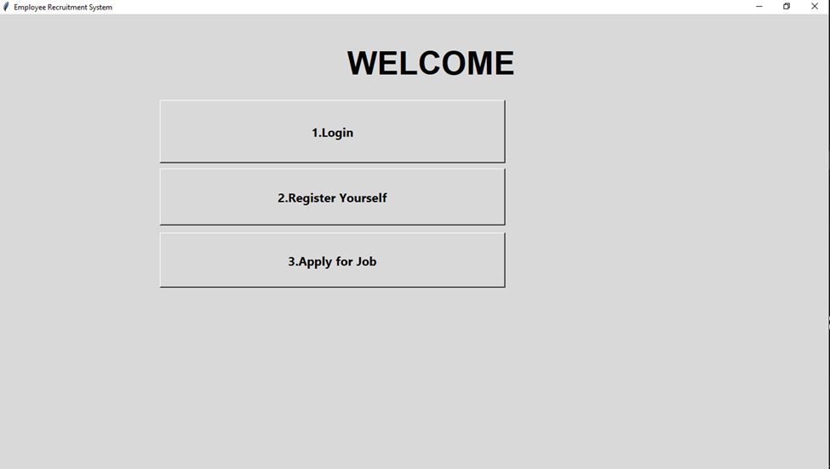
Recruitment Management System

Slide 4
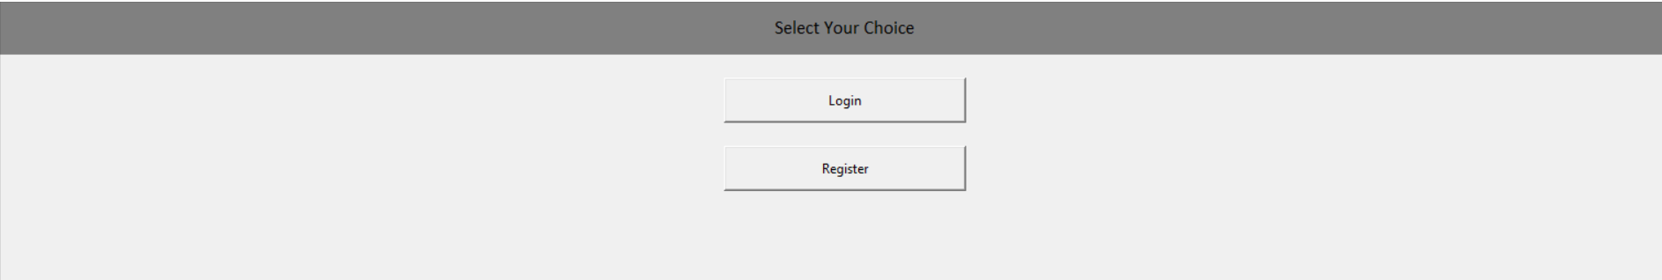
Login/Register Module
In this Module:
Jobseeker is able to register with a new account.
Jobseeker is able to log-in into his/her account.

Slide 5
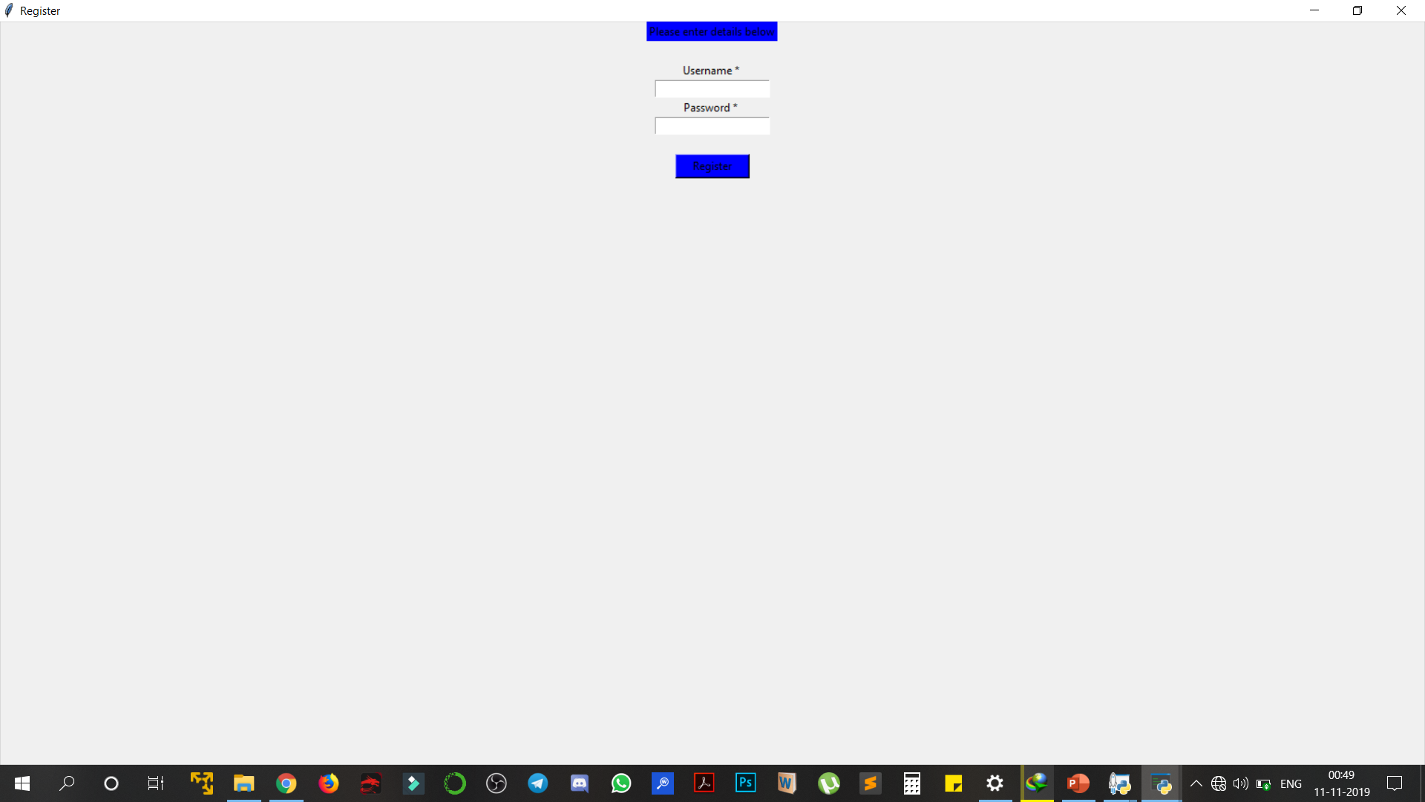
User can register or login using a valid email and password.
Login Module will ask for username and password of the registered user.
The details will be matched with database for existence.
If details exist: Login Successful
If details don’t exist: User Does not exist

Slide 6
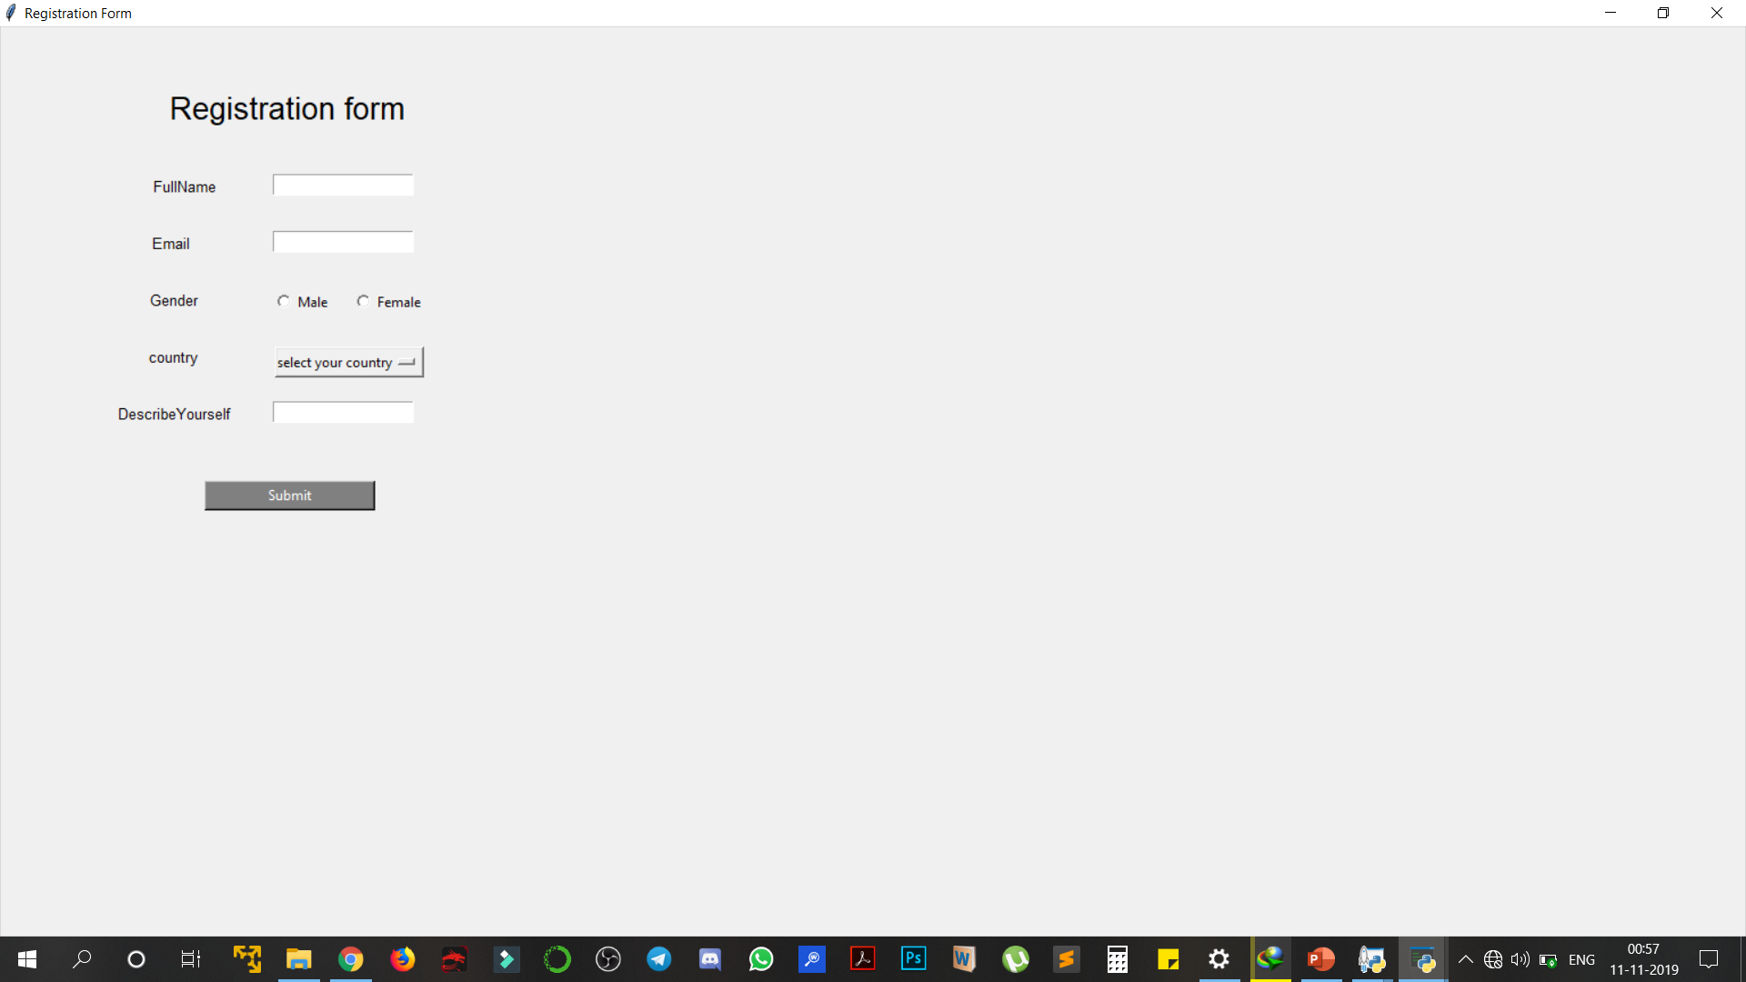
Registration Form Module
User can register themselves in this module.
User can add extra details to their profile in Describe Yourself.
User is required to select gender and country before successfully registering into the system.

Slide 7
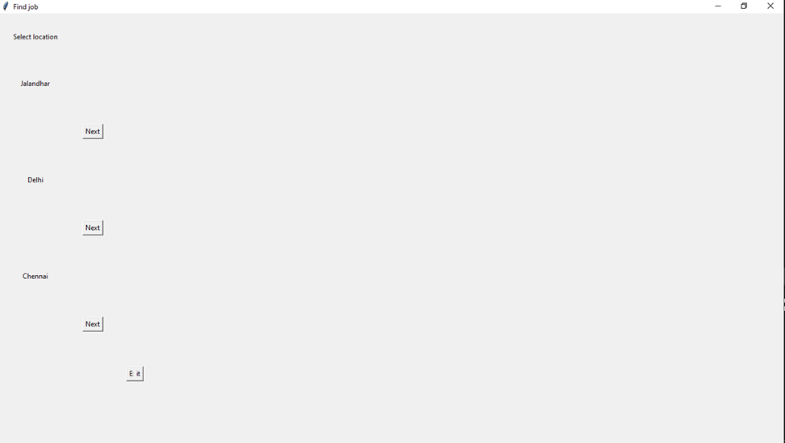
Search Jobs/Apply
Select the city in where you are looking for Job.

Slide 8
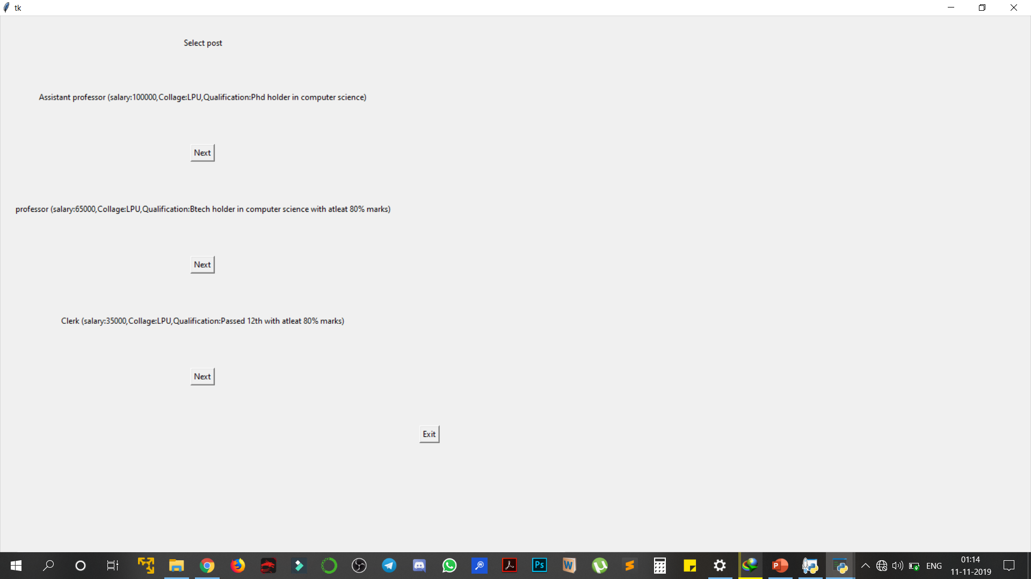
Select your desired post you want to apply for and Click Next.
All the details like position ,salary ,qualification , pre-requisites are mentioned below every available post.

Slide 9
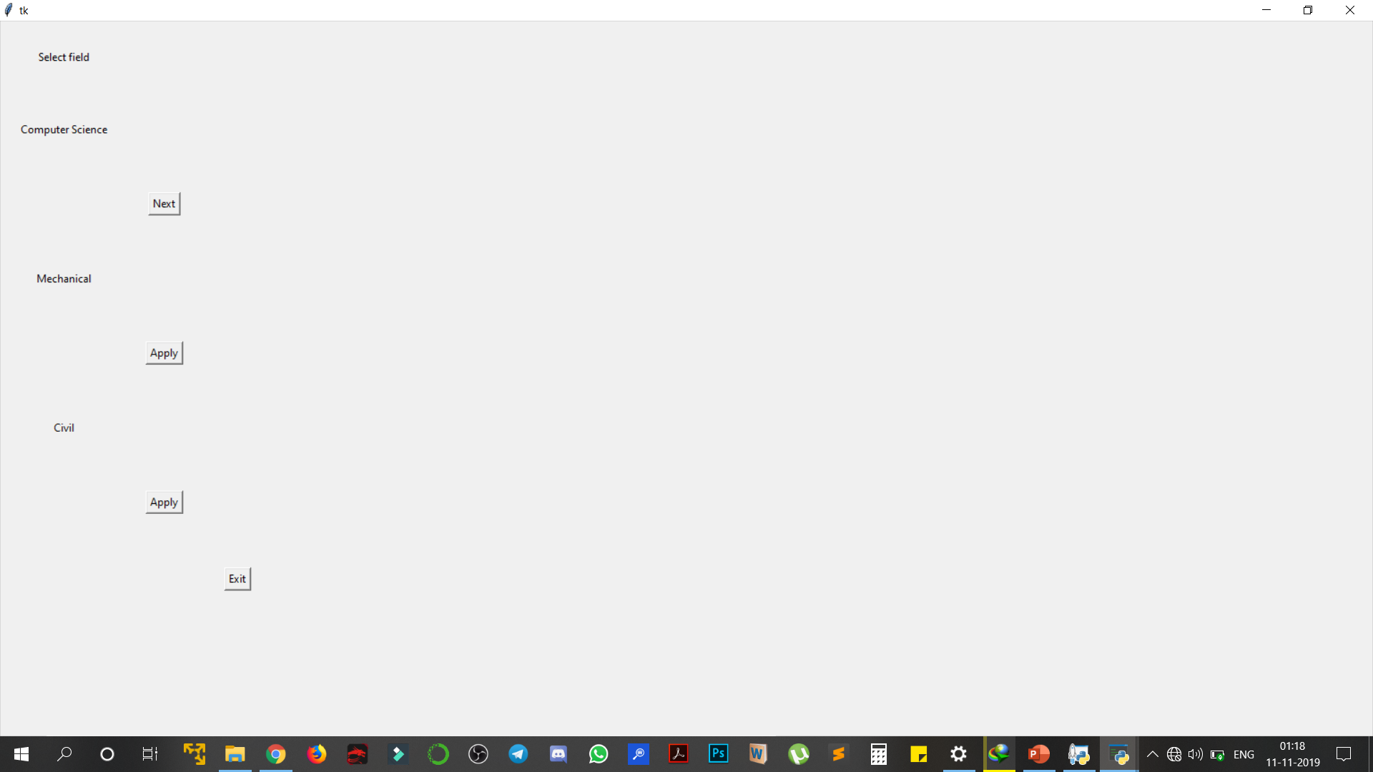
Now the user is required to select his field of specialisation and Click Next.

Slide 10
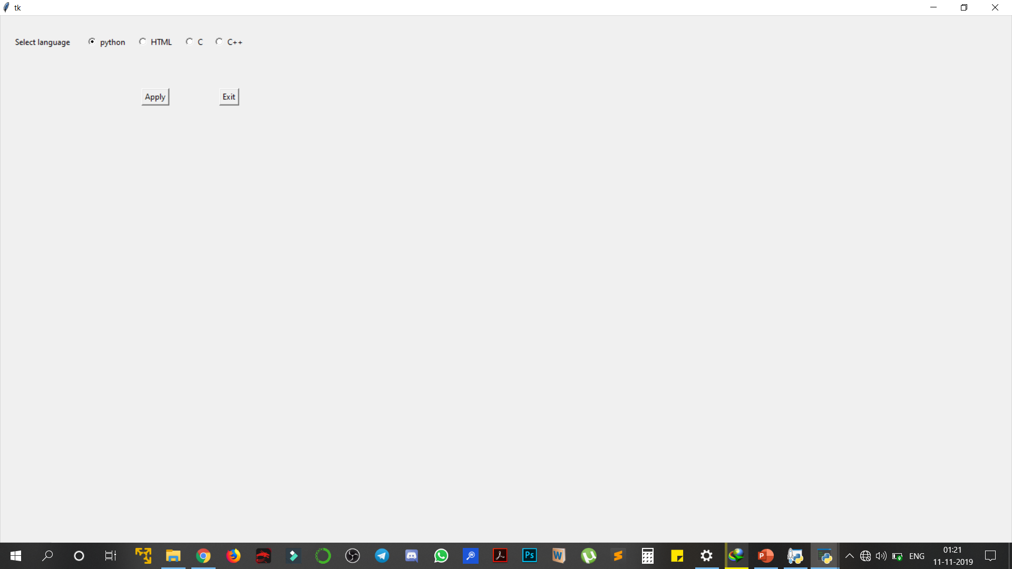
If user has CSE as his specialised course ,he /she is required to select a programming language and Click on Apply.

Slide 11
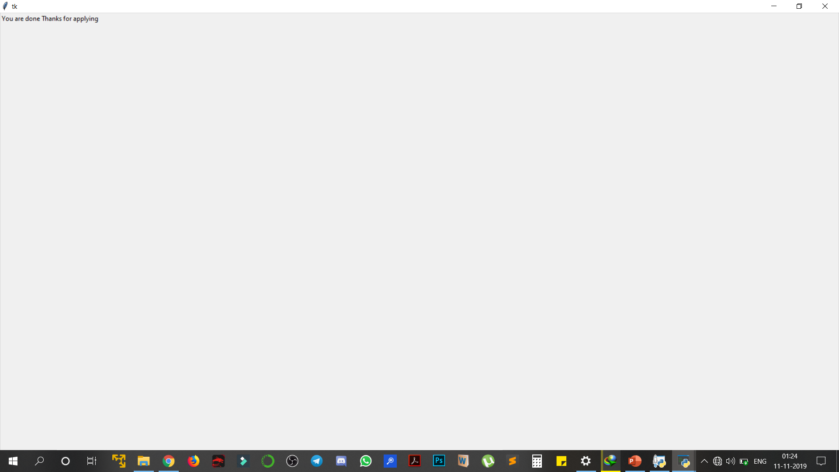
Now the user will be greeted with a message after successfully applying for the job.

Slide 12
THE END…

